Slide 1
HTML
Session 2
Text Content & Formatting

Slide 2
What You Will Learn in This Session
✓ Understand Standard vs Quirks Mode
✓ Master HTML Headings (h1-h6)
✓ Work with paragraphs and attributes
✓ Format text with HTML elements
✓ Create links and understand navigation
✓ Use span, break, and horizontal rule elements

Slide 3
Standard Mode vs Quirks Mode
Browser rendering modes affect how your webpage is displayed:
Standards Mode ✓
Quirks Mode ✗
• Triggered by correct DOCTYPE
• Follows W3C specifications
• Predictable behavior
• Modern CSS works correctly
• Recommended for all sites
• Missing or old DOCTYPE
• Emulates old browsers
• Unpredictable behavior
• CSS issues and bugs
• Avoid at all costs!
💡 Remember: Always include
<!DOCTYPE html>
to ensure Standards Mode!

Slide 4
HTML Headings (h1 - h6)
HTML provides 6 levels of headings, from most important (h1) to least important (h6):
<h1>Heading 1</h1>
Heading 1
<h2>Heading 2</h2>
Heading 2
<h3>Heading 3</h3>
Heading 3
<h4>Heading 4</h4>
Heading 4
<h5>Heading 5</h5>
Heading 5
<h6>Heading 6</h6>
Heading 6

Slide 5
Heading Best Practices
✓ DO:
✗ DON'T:
• Use only ONE <h1> per page (main title)
• Follow hierarchical order (h1 → h2 → h3)
• Use headings for structure, not styling
• Keep headings descriptive and meaningful
• Use headings to improve SEO and accessibility
• Skip heading levels (h1 → h4)
• Use headings just to make text bigger
• Have multiple <h1> tags on one page
• Use headings inside paragraphs
<!-- Good Structure -->
<h1>My Blog</h1>
<h2>Article Title</h2>
<h3>Section 1</h3>
<h3>Section 2</h3>
<h2>Another Article</h2>

Slide 6
The Paragraph Element
The <p> tag defines a paragraph of text. Browsers automatically add space before and after paragraphs.
<p>This is a paragraph.</p>
<p>This is another paragraph.</p>
<p>
Paragraphs can contain multiple lines.
The browser will automatically wrap text
and ignore extra spaces and line breaks.
</p>
Result:
This is a paragraph.
This is another paragraph.
Paragraphs can contain multiple lines. The browser will automatically wrap text and ignore extra spaces and line breaks.
💡 Important: HTML collapses multiple spaces and line breaks into a single space!

Slide 7
HTML Attributes
Attributes provide additional information about HTML elements. They are always specified in the opening tag.
<tagname
attribute
=
"value"
>Content</tagname>
Common Global Attributes:
Examples:
id - Unique identifier
class - CSS class name
style - Inline CSS
title - Tooltip text
lang - Language
<p id="intro">Text</p>
<div class="box">Content</div>
<h1 title="Main Heading">Title</h1>
<p lang="ar">مرحبا</p>

Slide 8
Text Formatting Elements - Part 1
HTML provides many elements for formatting text:
Bold:
Result:
Bold Text
Code:
<b>Bold Text</b>
Makes text bold (no semantic meaning)
Strong:
Result:
Important Text
Code:
<strong>Important Text</strong>
Bold + semantic importance
Italic:
Result:
Italic Text
Code:
<i>Italic Text</i>
Makes text italic (no semantic meaning)
Emphasis:
Result:
Emphasized Text
Code:
<em>Emphasized Text</em>
Italic + semantic emphasis
Mark:
Result:
Highlighted
Code:
<mark>Highlighted</mark>
Marks/highlights text

Slide 9
Text Formatting Elements - Part 2
Small:
Result:
Small Text
Code:
<small>Small Text</small>
Makes text smaller
Delete:
Result:
Deleted Text
Code:
<del>Deleted Text</del>
Shows deleted/removed text
Insert:
Result:
Inserted Text
Code:
<ins>Inserted Text</ins>
Shows inserted/added text
Subscript:
Result:
H₂O
Code:
<sub>H₂O</sub>
Subscript text (chemistry, math)
Superscript:
Result:
X²
Code:
<sup>X²</sup>
Superscript text (exponents, footnotes)
💡 Best Practice: Prefer <strong> over <b> and <em> over <i> for better semantics and accessibility!

Slide 10
Links - The Anchor Tag
The <a> (anchor) tag creates hyperlinks. The href attribute specifies the destination URL.
<!-- External Link -->
<a href="https://www.google.com">Visit Google</a>
<!-- Link to another page in your site -->
<a href="about.html">About Us</a>
<!-- Link to a section on the same page -->
<a href="#section1">Go to Section 1</a>
<!-- Email Link -->
<a href="mailto:info@example.com">Email Us</a>
<!-- Phone Link -->
<a href="tel:+1234567890">Call Us</a>
Result:
Visit Google

Slide 11
Link Attributes and Target
target Attribute:
<!-- Open in new tab -->
<a href="https://google.com" target="_blank">Google</a>
<!-- Open in same tab (default) -->
<a href="page.html" target="_self">Same Tab</a>
title Attribute:
<a href="about.html" title="Learn more about us">About</a>
Shows tooltip on hover
⚠️ Security Tip:
When using target="_blank", add rel="noopener noreferrer" for security:
<a href="https://example.com" target="_blank" rel="noopener noreferrer">Link</a>

Slide 12
The Span Element
<span> is an inline container used to style or manipulate a part of text.
<p>
This is <span style="color: red;">red text</span>
in a paragraph.
</p>
<p>
Price: <span class="price">$99.99</span>
</p>
<p>
The word <span id="highlight">important</span>
stands out.
</p>
Result:
This is
red text
in a paragraph.
Price:
$99.99
💡 Key Point: <span> has no visual effect by itself. Use it with CSS classes or styles to format inline content.

Slide 13
Line Break <br> and Horizontal Rule <hr>
<br> - Line Break
<hr> - Horizontal Rule
<p>
First line<br>
Second line<br>
Third line
</p>
<h2>Section 1</h2>
<p>Content here...</p>
<hr>
<h2>Section 2</h2>
<p>More content...</p>
Result:
Result:
First line
Second line
Third line
Section 1
Content here...
Section 2

Slide 14
Session 2 Summary
What We Learned Today:
✓ Understanding browser rendering modes
✓ Using HTML headings (h1-h6) properly
✓ Working with paragraphs and text
✓ HTML attributes and their usage
✓ Text formatting elements (strong, em, mark, etc.)
✓ Creating links with the anchor tag
✓ Using span, br, and hr elements
Next Session: Images, Lists, Tables & More!

Slide 15
Session 2 Tasks
🎯 Your Tasks
Complete these exercises before the next session:
Task 1: Create a Blog Post
Create an HTML page with an h1 title, h2 subtitles, multiple paragraphs, and use at least 5 different formatting elements (strong, em, mark, etc.).
Task 2: Navigation Menu
Create a simple navigation menu with 5 links. Include both internal links (to sections on the same page) and external links. Use proper target and rel attributes.
Task 3: Format a Recipe
Create a recipe page with a title, ingredients (use formatting for measurements), instructions with line breaks, and use hr to separate sections. Style some text with span elements.

Slide 16
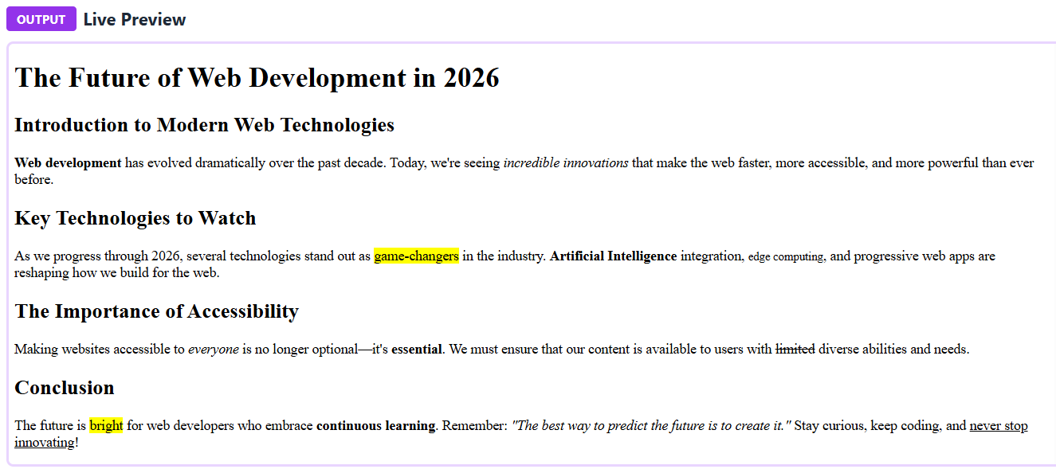

Slide 17
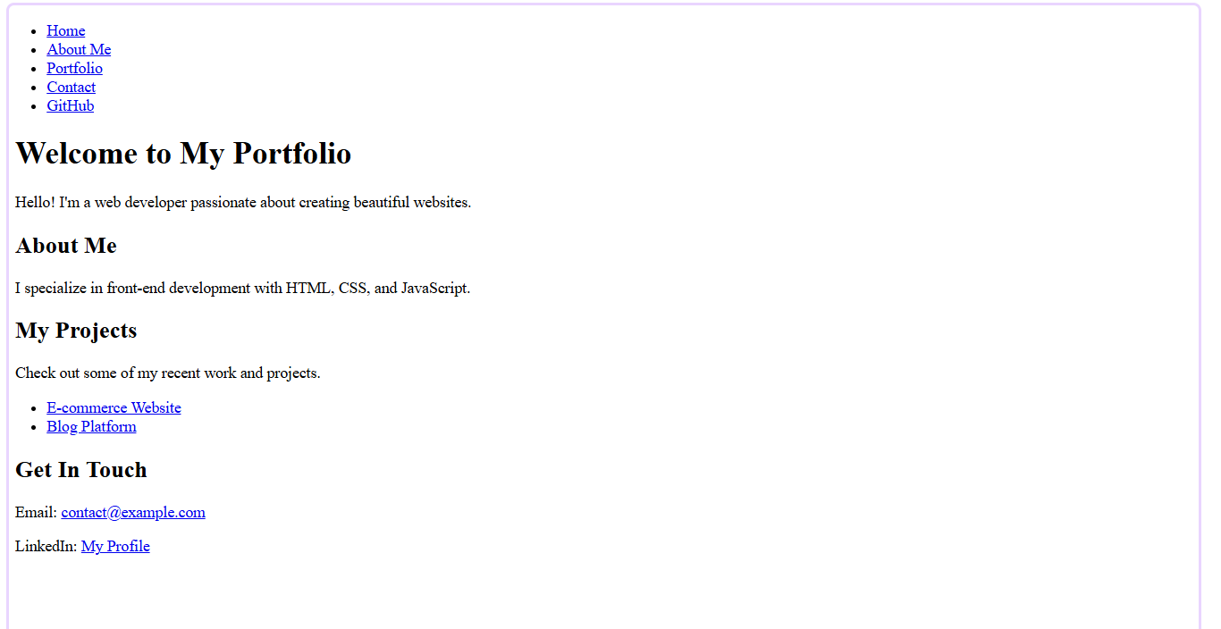

Slide 18
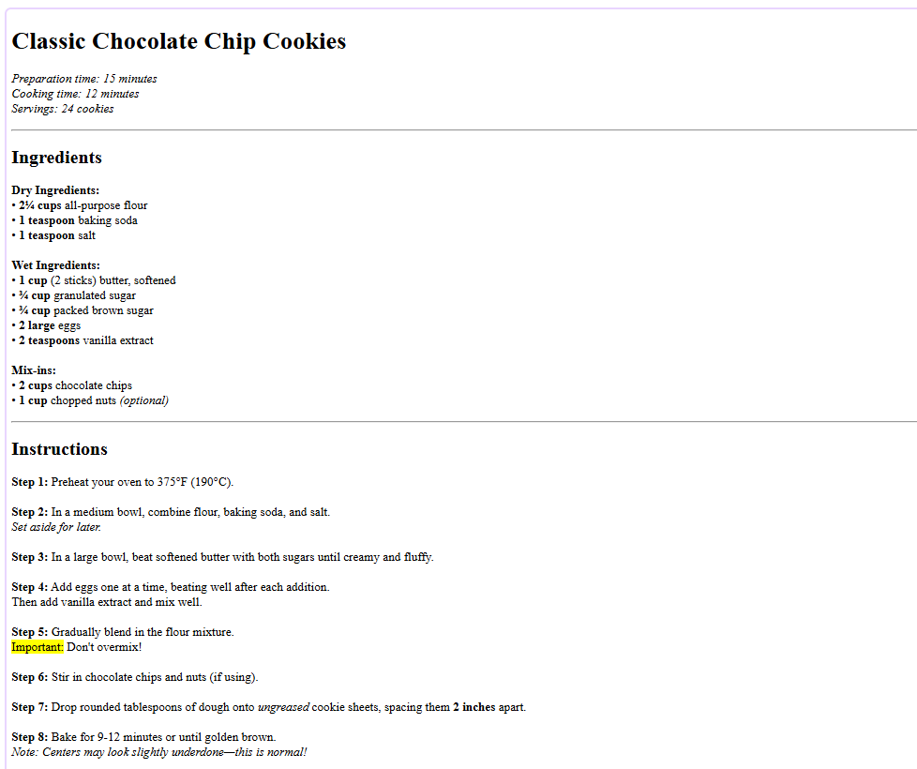

Slide 19


